Slide 1
Propositional Logic Chapter 1, Rosen
Computer Science, Purdue University
Copyright McGraw Hill, Rosen.
Notes:
In this lecture, we discuss compound propositions, and when two compound propositions are logically equivalent. To do this, we introduce deMorgan’s laws and other basic logical equivalences. We conclude the lecture with an example application of basic logical equivalences to prove the equivalence of two given logic expressions.

Slide 2
Propositional Logic
Equivalent Propositions
Two propositions are equivalent if they always have the same truth value.
Example: Show using a truth table that the conditional is equivalent to the contrapositive.
Solution:
p | q | ¬ p | ¬ q | p →q | ¬q → ¬ p
T | T | F | F | T | T
T | F | F | T | F | F
F | T | T | F | T | T
F | F | T | T | T | T
Computer Science, Purdue University

Slide 3
Propositional Logic
Precedence of Logic Operators
Operator | Precedence
¬ | 1
∧ ∨ | 2 3
→ ↔ | 4 5
p ∨q → ¬r is equivalent to (p ∨q) → ¬r
If the intended meaning is p ∨(q → ¬r )
then parentheses must be used.
Computer Science, Purdue University

Slide 4
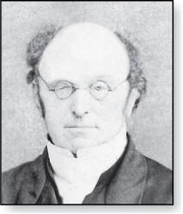
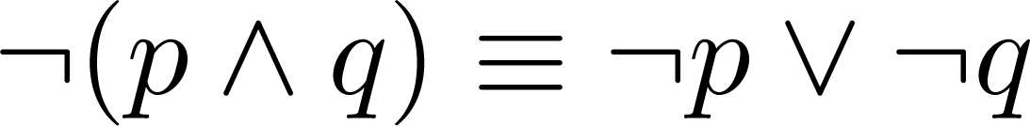
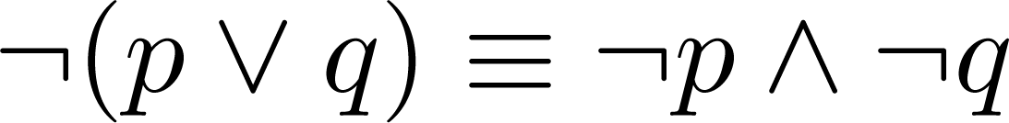
Propositional Logic
DeMorgan’s Laws
Augustus De Morgan
This truth table shows that De Morgan’s Second Law holds.
1806-1871
p | q | ¬p | ¬q | (p∨q) | ¬(p∨q) | ¬p∧¬q
T | T | F | F | T | F | F
T | F | F | T | T | F | F
F | T | T | F | T | F | F
F | F | T | T | F | T | T
Computer Science, Purdue University

Slide 5
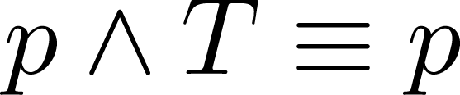
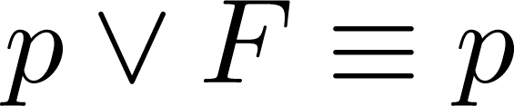
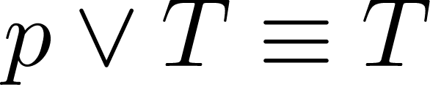
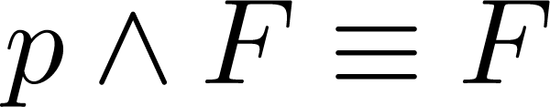
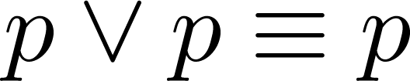
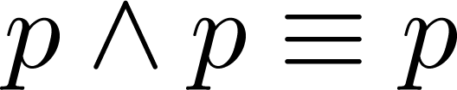
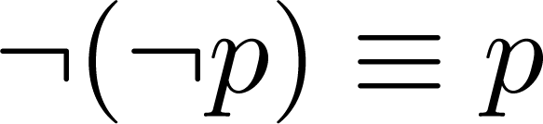
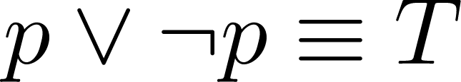
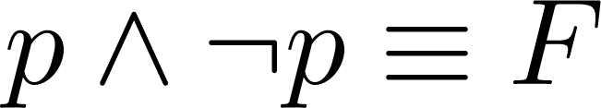
Propositional Logic
Key Logical Equivalences
Identity Laws:
Domination Laws:
Idempotent laws:
Double Negation Law:
Negation Laws:
Computer Science, Purdue University

Slide 6
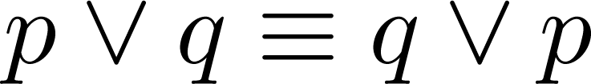
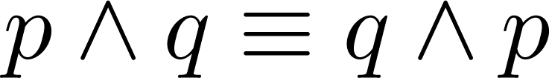
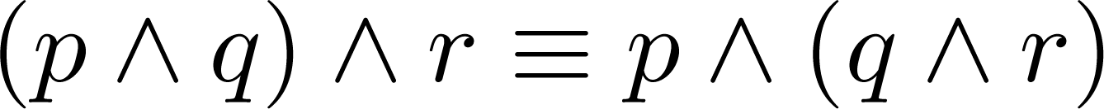
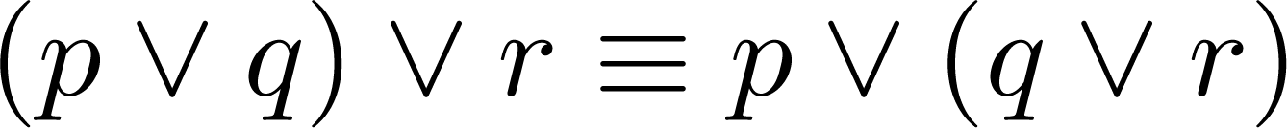
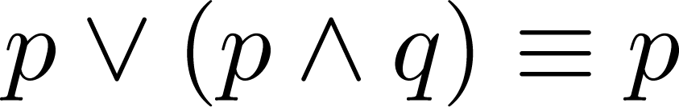
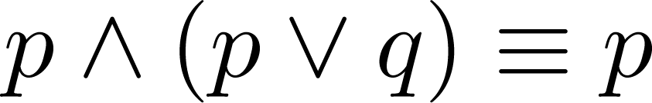
Propositional Logic
Key Logical Equivalences
Commutative Laws:
Associative Laws:
Distributive Laws:
Absorption Laws:
Computer Science, Purdue University

Slide 7


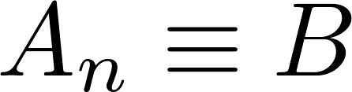
Propositional Logic
Constructing New Logical Equivalences
We can show that two expressions are logically equivalent by developing a series of logically equivalent statements.
To prove that we produce a series of equivalences beginning with A and ending with B.
Keep in mind that whenever a proposition (represented by a propositional variable) occurs in the equivalences listed earlier, it may be replaced by an arbitrarily complex compound proposition.
Computer Science, Purdue University

Slide 8
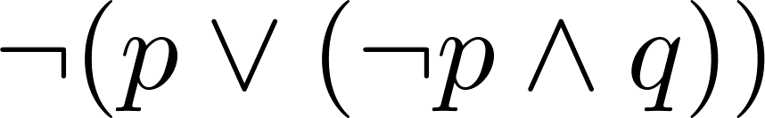
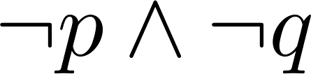
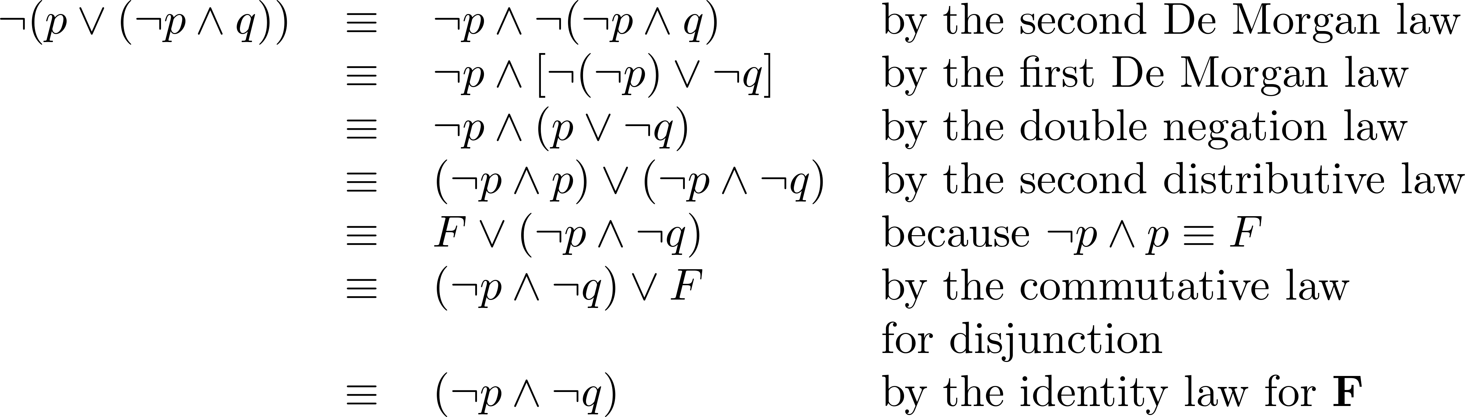
Propositional Logic
Equivalence Proofs
Example: Show that
is logically equivalent to
Solution:
Computer Science, Purdue University

Slide 9
Thank You

